Slide 1
AQI Monitoring System
Sinhgad College of Engineering, Pune
Department of E&TC
T. E. E&TC - (Mini – Project)
Group No: C21
By:
Jayesh Sangore 304C027
Aditya Sargar 304C028
Ayush kumar Lohani 304C029
Guide: Dr. D. G. Ganage , Dr. Y.M. Patil
2024-25, Sem: II

Slide 2
Problem Statement
Air pollution poses serious health risks , localized air quality data is often inaccessible. This project aims to develop a real-time AQI monitoring system that measures key pollutants and provides accessible data to raise awareness and support timely action.

Slide 3
Contents
Introduction of the projects
Aim and Objectives
Block Diagram
Circuit Diagram
Hardware and Software Requirements
Simulation Results
Applications of the Project
Conclusion
References

Slide 4
Introduction
The Air Quality Index (AQI) is a measure used to assess air pollution levels.
This project simulates AQI measurement using ESP32 in Proteus.
Sensors used: MQ-135, DHT22, and GP2Y1010AU0F (Dust Sensor).
A DC motor is activated via a relay when dust levels exceed a threshold.

Slide 5
Literature Survey
Air pollution monitoring is crucial due to its health and environmental impacts. Traditional systems are accurate but expensive and stationary, limiting real-time, localized data access.
Recent research focuses on IoT-based AQI systems using low-cost sensors like MQ135, SDS011, and DHT11 to measure pollutants. Microcontrollers (Arduino, Raspberry Pi) and cloud platforms (ThingSpeak, Blynk) enable real-time data collection and visualization. Some studies also explore machine learning for AQI prediction.
Despite these efforts, most existing solutions lack affordability, portability, and accessibility, especially in semi-urban and rural areas. This project addresses these gaps with a compact, real-time AQI monitoring system.

Slide 6
Aim & Objectives
Aim:
To design a simulation-based AQI monitoring system using ESP32 in Wokwi.
Objectives:
Measure air quality parameters (CO, Smoke, Alcohol, Temperature, Humidity, Dust).
Implement a Wokwi-based simulation for hardware testing.
Control a DC motor when dust levels are high.
Use a relay module for motor actuation.

Slide 7
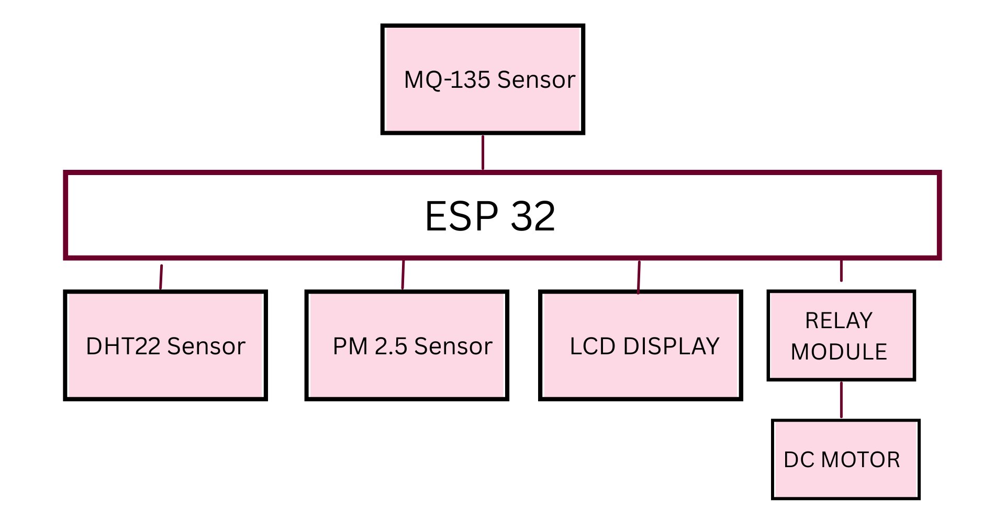
Block Diagram of AQI monitoring System

Slide 8
Block Diagram
Components Involved:
ESP32 Microcontroller (Arduino-based firmware)
MQ-135 Sensors (CO, Smoke, Alcohol detection)
DHT22 Sensor (Temperature & Humidity measurement)
GP2Y1010AU0F Sensor (Dust detection using a potentiometer for simulation)
Relay Module (For motor control)
DC Motor (Activated at high dust levels)

Slide 9
Block Diagram Explanation
This system uses an ESP32 microcontroller to collect and process data from multiple environmental sensors:
MQ-135 Sensors: Detect gases like smoke, alcohol, CO, and other pollutants.
GSM is used to send real time updates on phone using WIFI.
DHT22 Sensor: Measures temperature and humidity.
PM2.5 Sensor: Detects fine particulate matter (PM2.5), a key AQI parameter.
LCD Display: Shows real-time air quality and environmental readings.
Relay Module + DC Motor: Controls a fan or purifier based on AQI levels for automated air quality control.
The ESP32 acts as the central unit, reading data from sensors, displaying it, and activating the motor when necessary.

Slide 10
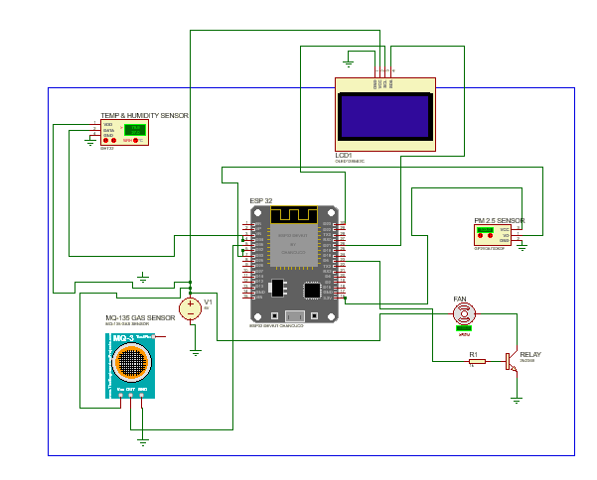
Circuit Diagram

Slide 11
Circuit Diagram
The Proteus simulation will include:
ESP32 microcontroller.
MQ-135, DHT22, GP2Y1010AU0F sensors.
A relay module for switching a DC motor.
Power supply configuration.
LCD/Serial Monitor for displaying AQI data.

Slide 12
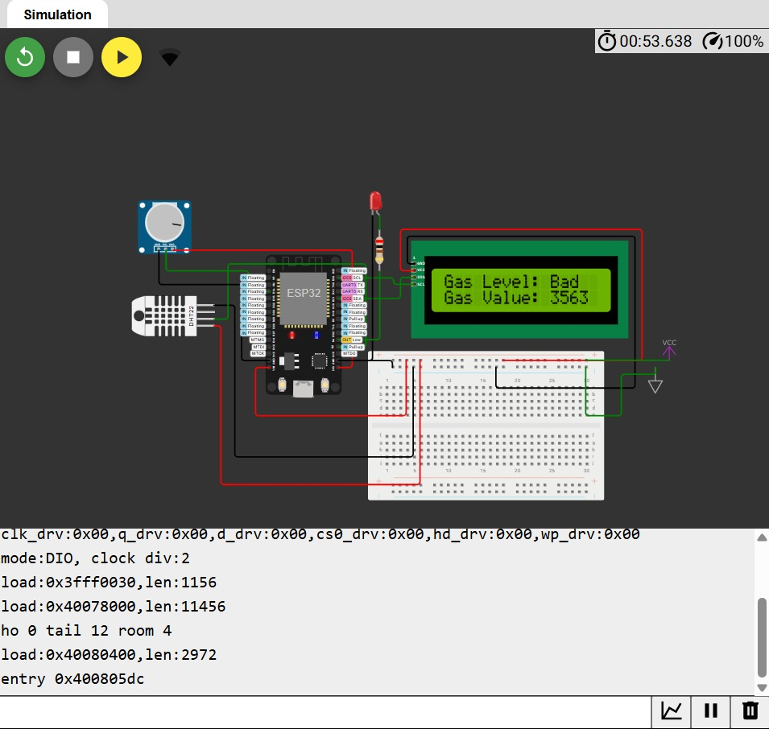
Wokwi Simulation

Slide 13
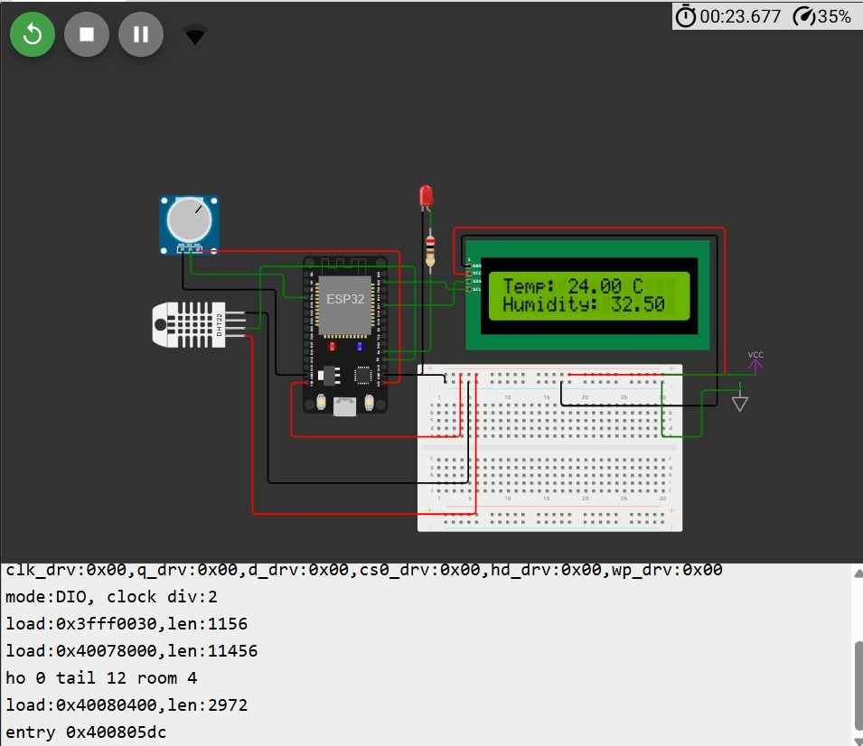
Wokwi Simulation

Slide 14
Simulation Results
Real-time AQI values displayed on LCD/Serial Monitor.
Proper sensor response to simulated environmental changes.
Successful display of Temperature and Humidity parameters.
Air Quality level along with its level of purity.

Slide 15
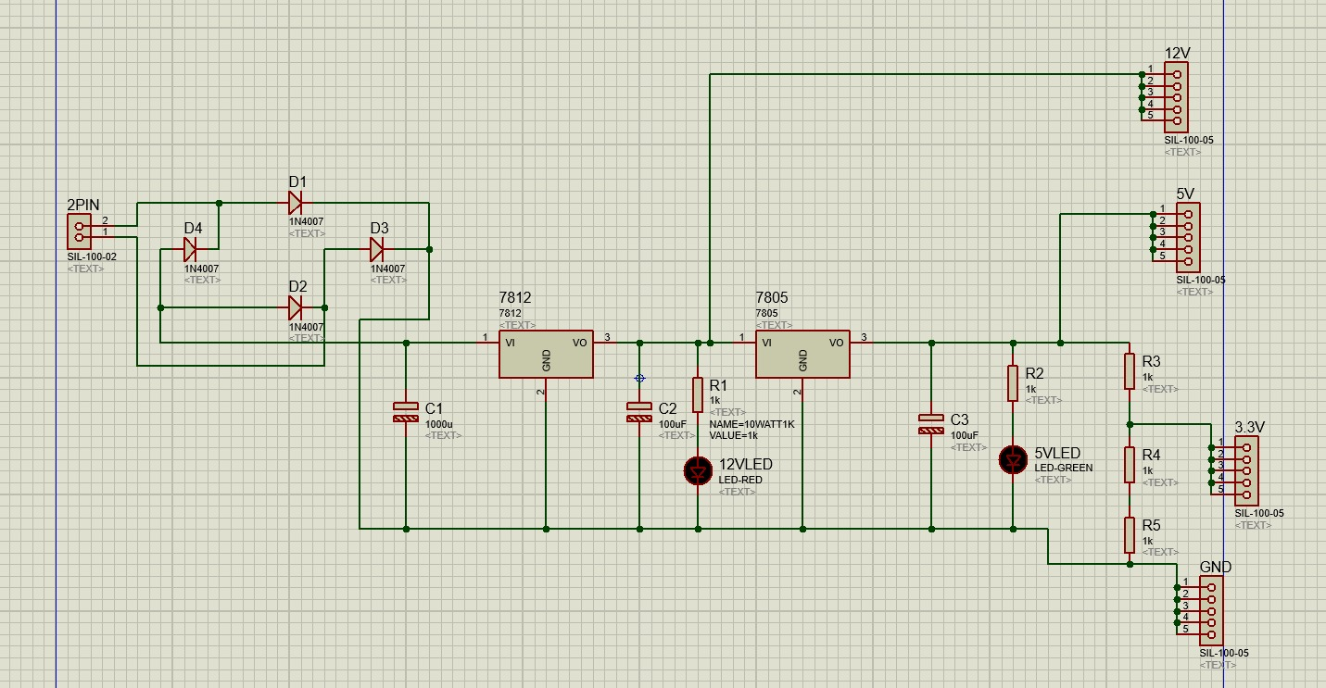
Power Supply Simulation

Slide 16
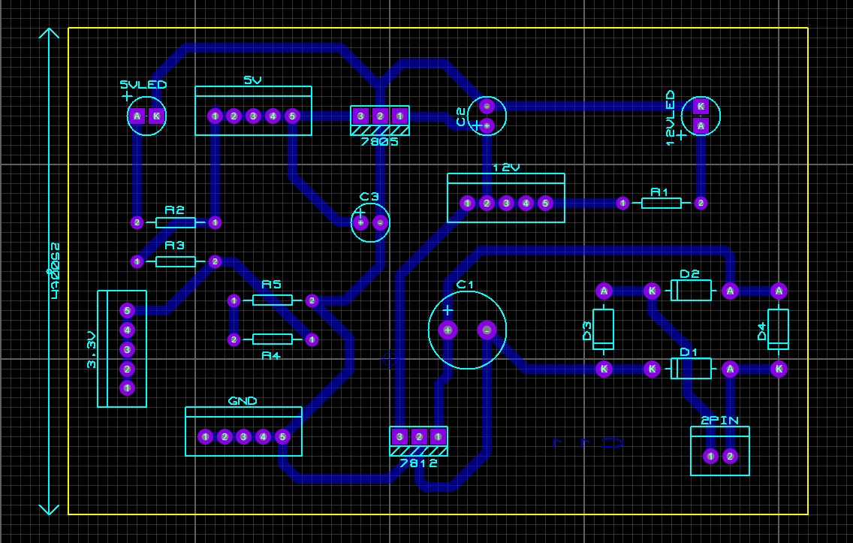
PCB Layout

Slide 17
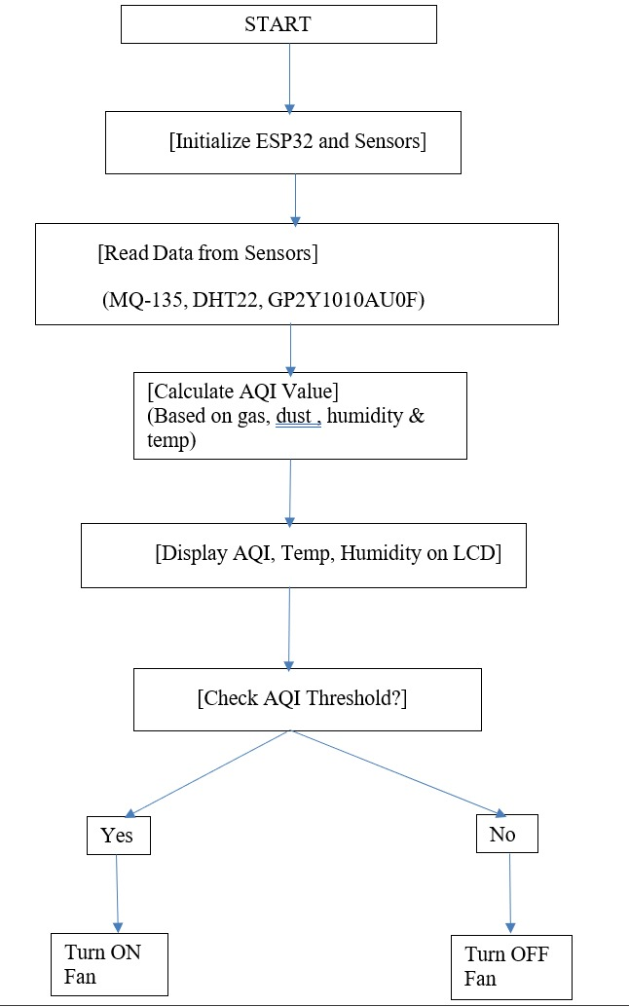
Flow chart

Slide 18
Hardware Requirements
Hardware:
ESP32 Microcontroller
MQ-135 Sensors
DHT22 Sensor
GP2Y1010AU0F Dust Sensor (Simulated using a potentiometer)
Relay Module & DC Motor
Power Supply (5V, 12V)
OLED Display
Jumper wires

Slide 19
Hardware Specifications
Component | Operating Voltage | Current Consumption
ESP32 | 1.8V – 5.5V | 0.2mA – 20mA (Active Mode)
MQ-135 Sensor | 5V | ~150mA – 200mA
DHT22 Sensor | 3.3V – 5V | 0.5mA (Measuring)
GP2Y1010AU0F | 5V | 20mA (Typical)
Potentiometer | Variable (Simulated) | Negligible
Relay Module | 5V | ~70mA (Trigger), ~150mA (Relay ON)
DC Motor | 5V | 200mA – 1A (Depending on Load)
OLED | 5V | ~1mA (Without Backlight), ~20mA (With Backlight)

Slide 20
Software requirements
Software:
Arduino IDE (Code development)
Proteus (Simulation and circuit design)
WOKWI
KiCad
Libraries
)

Slide 21
Applications
Air pollution monitoring in cities.
Indoor air quality assessment for homes and offices.
Smart automation systems for environmental control.
Health and safety applications in industrial zones.

Slide 22
Limitations
Sensor Accuracy
Low-cost sensors like MQ135 or GP2Y1010AU0F have limited accuracy compared to industrial-grade devices.
They may show fluctuations or noise in readings due to environmental factors.
Calibration Challenges
Sensors need manual calibration, and results can vary depending on temperature, humidity, and pressure.
Environmental Interference
Humidity, temperature, or dust can interfere with sensor readings, leading to inconsistent AQI values.

Slide 23
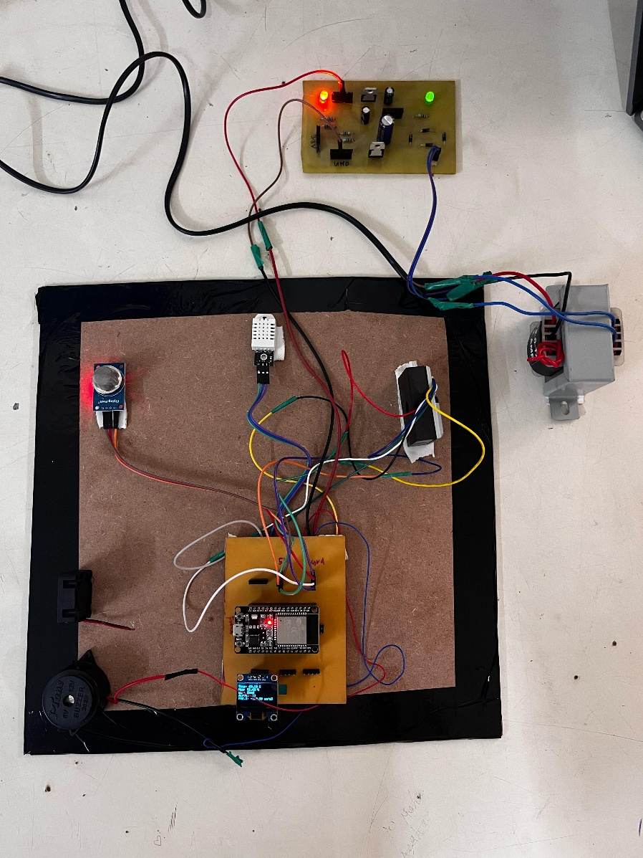
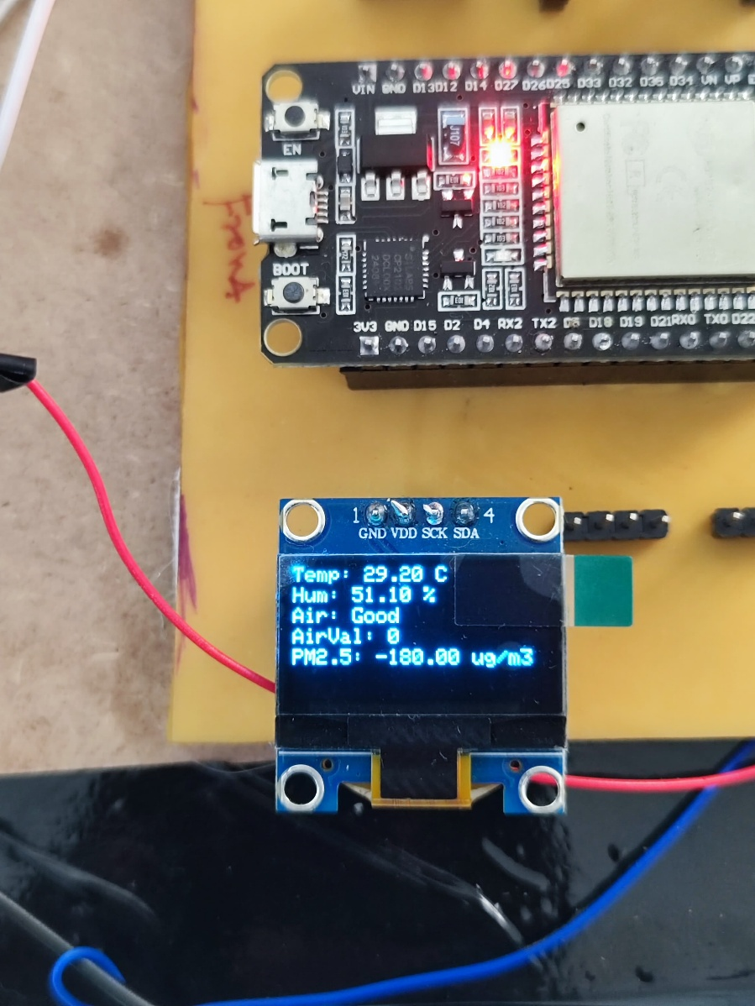
Results

Slide 24
Conclusions
Successfully simulated an AQI monitoring system using Proteus.
The system effectively measures air quality parameters.
Automation of DC motor activation at high pollution levels.
The project can be further extended to real-world applications using IoT.

Slide 25
Future Scope
Mobile or Web App development to visualize AQI trends.
Machine learning models to predict pollution levels.
Weather data integration for more accurate AQI analysis.
GPS-based location tagging for mapping air quality in different areas.
Battery optimization for better portability and outdoor use.
Crowdsourced sensor network to build community-driven air quality maps.
Auto-calibration system to improve sensor accuracy over time.

Slide 26
References
[1] J.-H. Liu, Y.-C. Lin, and C.-H. Chen, "An Air Quality Monitoring System for Urban Areas Based on the Technology of Wireless Sensor Networks," Int. J. Smart Sens. Intel. Syst., vol. 5, no. 1, pp. 191–214, Mar. 2012. ​Sciendo
[2] Y. Sung, S. Lee, Y. Kim, and H. Park, "Development of a Smart Air Quality Monitoring System and its Operation," Asian J. Atmos. Environ., vol. 13, no. 1, pp. 30–38, Jun. 2019. ​SpringerLink
[3] E. U. Oyo-Ita, U. J. Ekah, P. Ana, and I. O. Ewona, "Development of a Smart Air Quality Monitoring System Using Wireless Sensors," Adv. Res., vol. 24, no. 6, pp. 50–59, Sep. 2023. ​journalair.com
[4] Y. Tong, M. Xu, Z. Yu, and T. Zhang, "Design of Air Quality Monitoring System Based on Light Scattering Sensor," IOP Conf. Ser.: Earth Environ. Sci., vol. 647, no. 1, p. 012196, 2021. ​IOPscience
[5] P. Purwanto, S. Suryono, and S. Sunarno, "Design of Air Quality Monitoring System Based on Web Using Wireless Sensor Network," J. Phys.: Conf. Ser., vol. 1295, no. 1, p. 012043, 2019. ​IOPscience

Slide 27
Thank You

